Slide 1
Transformers
WHAT ALL DO YOU KNOW…………….??

Slide 2
BASICS
Transformer
Consists of two coils, a primary winding and a secondary winding
Rated in volt-amperes (VA)
Primary winding
Coil containing the AC voltage
Secondary winding
Coil in which the voltage is induced

Slide 3
KEY TERMS
ELECTROMAGNETS
MAGNETIC INDUCTION
ELECTROMAGNETIC INDUCTION
MUTUAL INDUCTION
COEFFICIENT OF COUPLING (0 to 1)

Slide 4
DESIGN OF TRANSFORMER
Influenced by:
Frequency at which it will be used
Power it must handle
Voltage it must handle

Slide 5
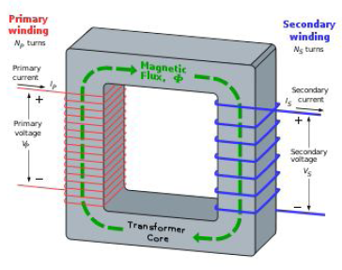



Slide 6
Turns Ratio
Turns ratio
Determines whether the transformer is used to step up, step down, or pass voltage unchanged
Can be expressed as:
turns ratio = N_{S}/N_{P}
where: N = number of turns
--- In the form of Ratio

Slide 7



Slide 8
Turns Ratio (cont’d.)
Step-up transformer
Produces a secondary voltage greater than its primary voltage
Turns ratio is always greater than one
Step-down transformer
Produces secondary voltage less than its primary voltage
Turns ratio is always less than one

Slide 9
Assuming no transformer losses:
Ps = Pp

Slide 10
CENTRE TAPPED TRANSFORMERS
Can be used to convert AC to DC

Slide 11
To keep the power loss during transmission less, current is decreased and is kept low.

Slide 12
Applications
Transformer applications include:
Stepping up/down voltage and current
Impedance matching
Phase shifting
Isolation
Blocking DC while passing AC
Producing several signals at various voltage levels
Transmitting electrical power to homes and industries

Slide 13

IMPEDANCE MATCHING TRANSFORMER

Slide 14
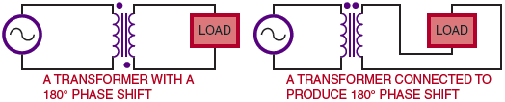
Applications (cont’d.)
Figure 18-5. A transformer can be used to generate a phase shift.

Slide 15
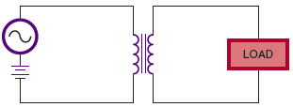
Applications (cont’d.)
Figure 18-6. A transformer can be used to block DC voltage.

Slide 16
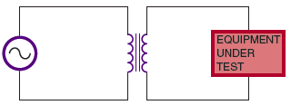
Applications (cont’d.)
Figure 18-7. An isolation transformer prevents electrical
shock by isolating the equipment from ground.

Slide 17
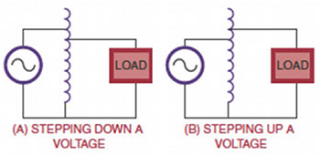
Applications (cont’d.)
Figure 18-8. An autotransformer is a special type of transformer
used to step up or step down the voltage.

Slide 18
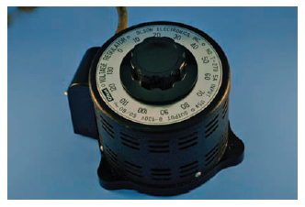
Applications (cont’d.)
Figure 18-9. A variable autotransformer.

Slide 19
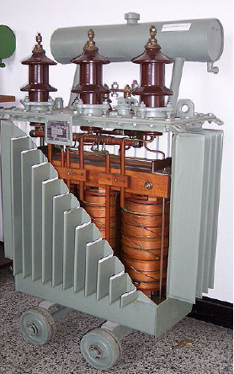
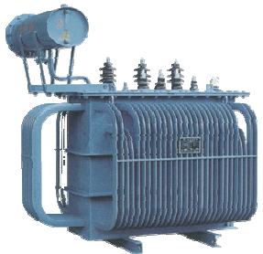
Power Transformers

Slide 20
Electrical motors

Slide 21
What is an electric motor?
An electric motor is an electromechanical device that converts electrical energy into mechanical energy.
All electric motors operate through the interaction of magnetic fields and current-carrying conductors to generate force.

Slide 22
Classification of Electric motors
Electrical motors are broadly classified on the availability of type of supply. They are,
DC motors
AC motors
DC/AC motors

Slide 23
How to find the direction of Force acting the conductor
According to the Faraday’s laws of electromagnetic induction,
whenever a current carrying conductor is placed in a magnetic field, it experiences a force.
The direction of force acting on the conductor is found by Fleming’s left Hand Rule.

Slide 24
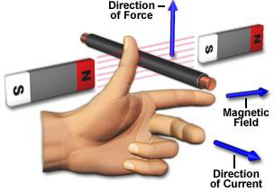
Flemings left hand rule
The direction of force exerted on the conductor is given by Fleming’s Left Hand Rule.
Thumb indicates the direction of force experienced by the conductor Index finger represents direction of magnetic field
Middle finger indicates direction of current

Slide 25
Principle of DC motors
The concept of working principle of DC motor involves the interaction of magnetic field and a current carrying conductor placed in it.
Let a straight conductor be placed in the magnetic field produced by a permanent magnet.
The interaction between the magnetic field and current carrying conductor is explained by Fleming’s right thumb hand rule.

Slide 26
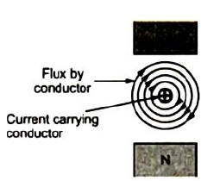
DC motors
Consider a conductor which is placed in a magnetic field (represented by flux lines from N-Pole to S-Pole) and the direction of current is as shown in the Figure shown in above slide.
Due to presence of two magnetic fields simultaneously, an interaction between them will take place as shown in Figure above.

Slide 27
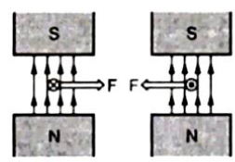
Magnitude of Force
The magnitude of the force experienced by the current carrying conductor placed in the magnetic field is given by
F = B I L sinθ Newton
Where,
B = Flux density (Wb)
I = Current flowing through the conductor (A)
L = Length of the conductor (m)

Slide 28
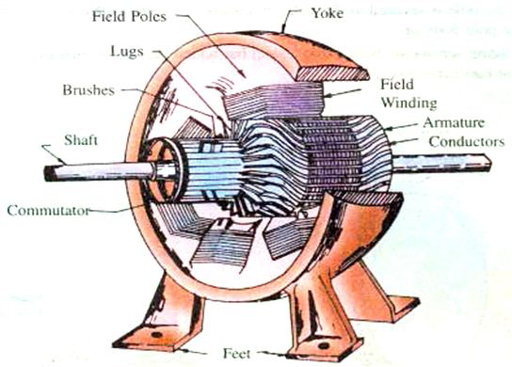
Construction of DC machine.

Slide 29
Functions of various parts of DC machine
Yoke
The outer frame or yoke serves double purpose.
It provides mechanical support for the poles and acts as a protecting cover for the whole machine and It carries the magnetic flux produced by the poles.

Slide 30
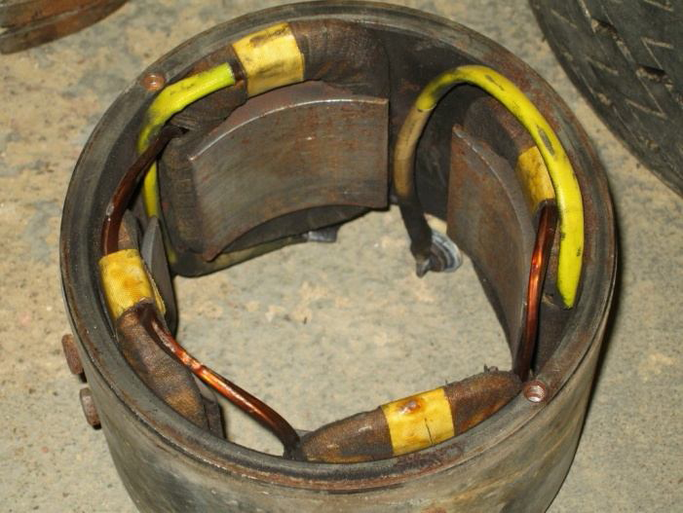
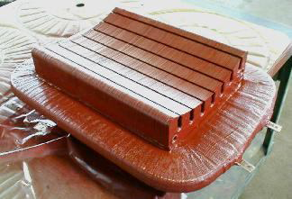
Pole cores/shoes
The field magnets consists of pole cores and pole shoes.
The pole shoes serve two purposes
They spread out the flux in the air gap and also, being of larger cross section reduce the reluctance of the magnetic path
They support the exciting coils (or field coils).

Slide 31
Field Poles

Slide 32
Pole Coils
The field coils or pole coils, which consist of copper wire of strip, are former-wound for the correct dimension.
Then the former is removed and wound coil is put into place over the core.
When current is passed through these coils, they electromagnetise the poles which produce the necessary flux that is cut by revolving armature conductors.

Slide 33
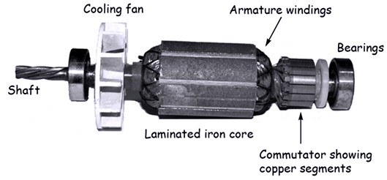
Armature core
It houses the armature conductors or coils and causes them to rotate and hence cut the magnetic flux of the field magnets.
Its most important function is to provide a path of very low reluctance to the flux through the armature from a N-pole to a S-pole.

Slide 34
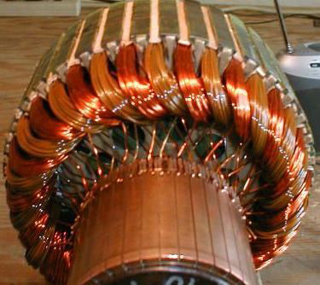
Armature windings
The armature windings are usually former-wound.
These are first wound in the form of flat rectangular coils and are then pulled into their proper shape in a coil puller.
Various conductors of the coils are insulated from each other.
The conductors are placed in the armature slots which are lined with tough insulating material.

Slide 35
Armature windings

Slide 36
Commutator
The function of Commutator is to
facilitate collection of current from the armature conductors
in case of motor which can provide current to the armature conductors

Slide 37
Brushes and Bearings
The brushes, whose function is to collect current from Commutator or to supply current to Commutator as in the case of generator and motor respectively, are usually made of carbon or graphite and are in the shape of a rectangular block

Slide 38
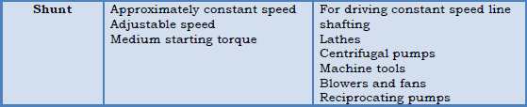

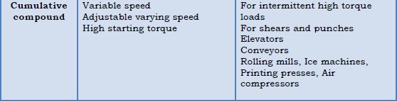
Applications of DC Motors

Slide 39
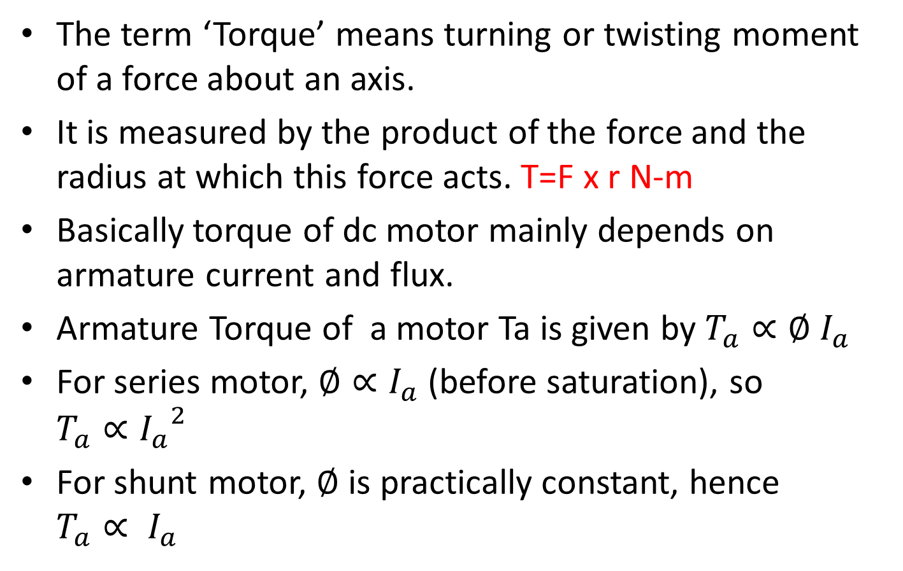
TORQUE
The term ‘Torque’ means turning or twisting moment of a force about an axis.
It is measured by the product of the force and the radius at which this force acts. T=F x r N-m
Basically torque of dc motor mainly depends on armature current and flux.
Armature Torque of a motor Ta is given by $T_{a}∝∅ I_{a}$
For series motor, $∅∝I_{a}$(before saturation), so $T_{a}∝{I_{a}}^{2}$
For shunt motor, $∅$ is practically constant, hence $T_{a}∝ I_{a}$

Slide 40
Why DC motors offer high as well as constant torque?
For a dc shunt motor, this flux is nearly a constant but for dc series motor this flux is mainly dependent on armature current, so torque of dc series motor is now dependent on square of armature current.
Hence it has a very high starting torque.

Slide 41
Types of AC motors
Synchronous
Permanent magnet synchronous motor
Switched reluctance synchronous motor
Hysteresis motor
Asynchronous (Induction motors)
Single-phase induction motors
Three-phase induction motors
Split phase induction motor
Squirrel cage
Slip-ring/wound rotor
Capacitor start induction motor
Shaded pole induction motor

Slide 42
Characteristics of motors
Depending upon the applications, motors can be designed according to the desired characteristics like,
Rotary
Linear
Servo
Spacecraft propeller
Generator

Slide 43
Applications of Electric motors
industrial fans
blowers and pumps
machine tools
household appliances
power tools
and disk drives

Slide 44
Application depends on Different sizes of motors
Smallest motors can be found in
Electric wrist watches
Medium size motors can be found
To provide convenient mechanical power for industrial use
The very largest electric motors are used
for propulsion of ships, pipeline compressors, and water pumps with ratings in the millions of watts.

Slide 45
Electric motors are classified on the basis of…
by the source of electric power
by their internal construction
by their application
or by the type of motion they give

Slide 46
That is the completion of Unit-3
ALL THE VERY BEST FOR YOUR MID TERM EXAMS!!

